Slide 1
FHIR Patient Portal – Visual Workflows (v3)
Simplified: no arrows, step numbers and grid layout

Slide 2
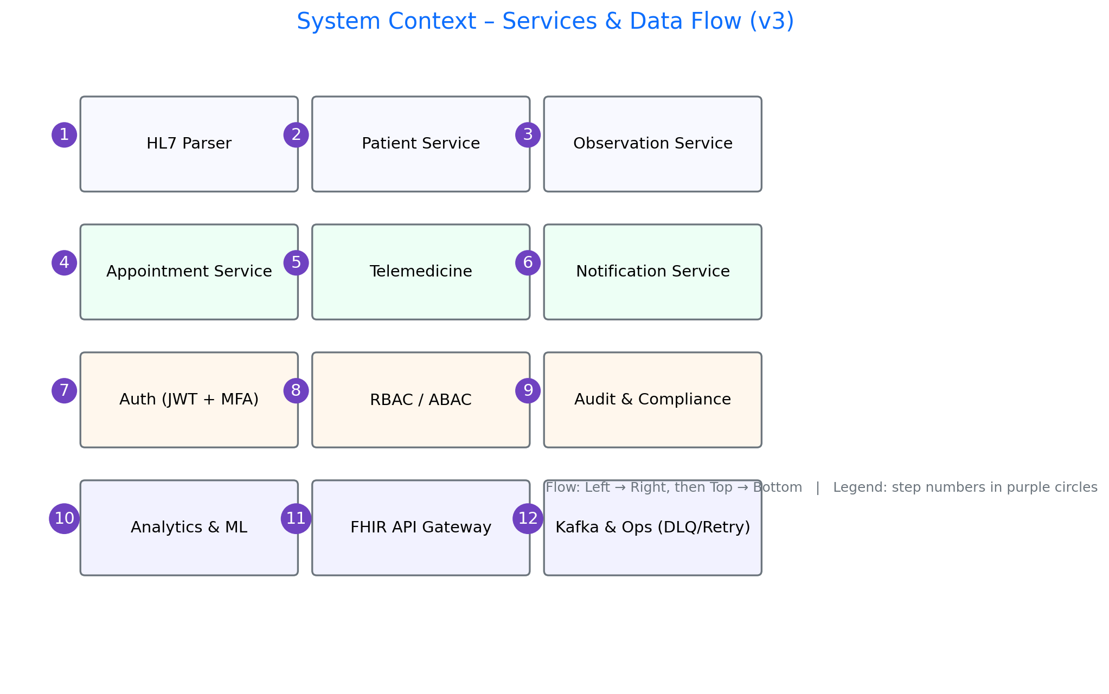
01 System Context

Slide 3
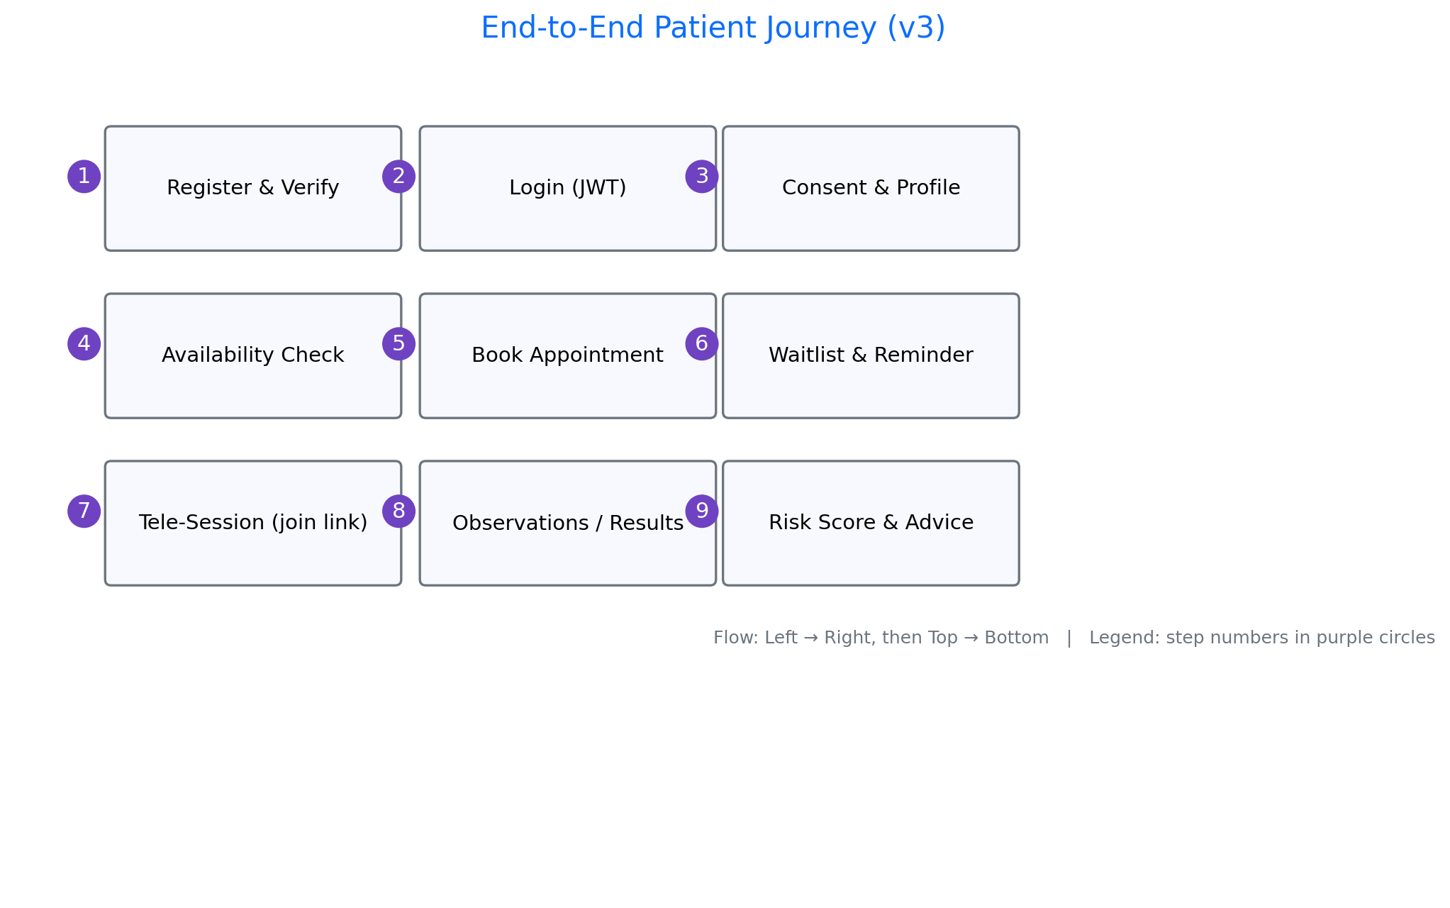
02 Patient Journey

Slide 4
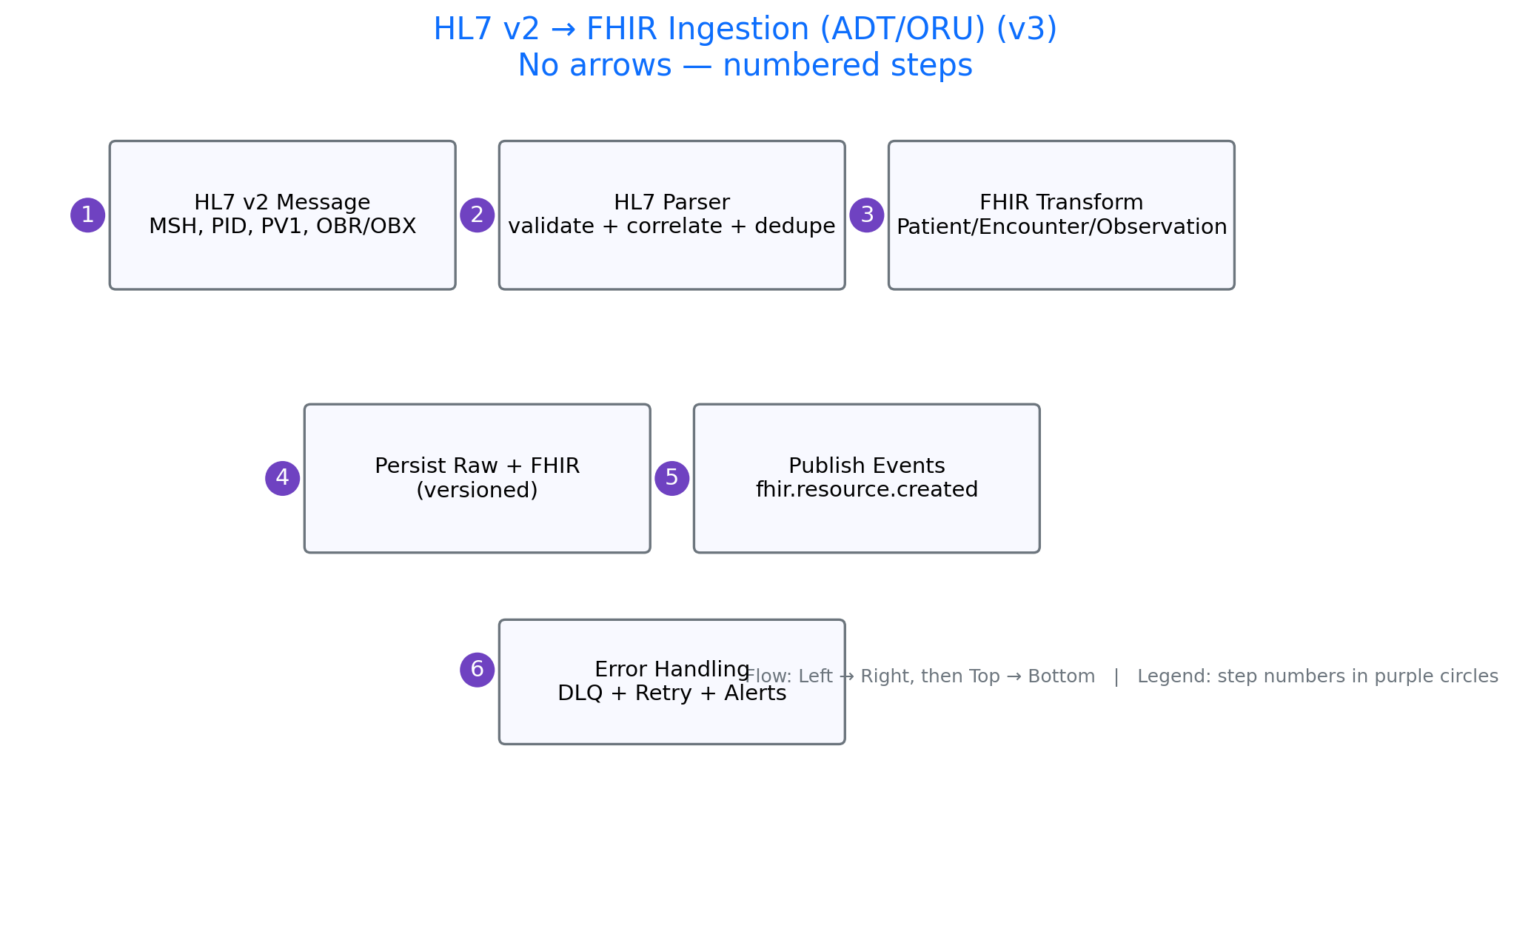
03 HL7 to FHIR

Slide 5
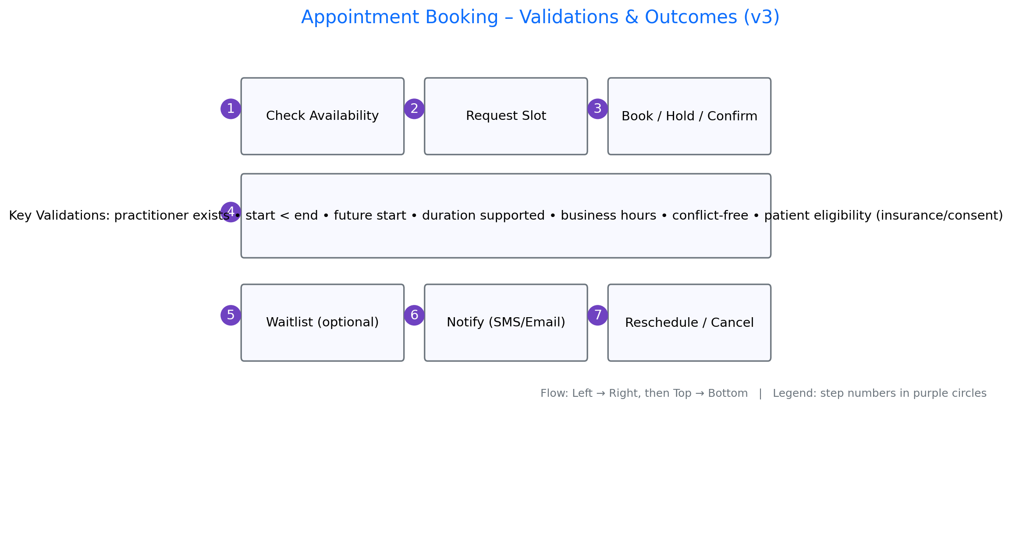
04 Appointment Flow

Slide 6
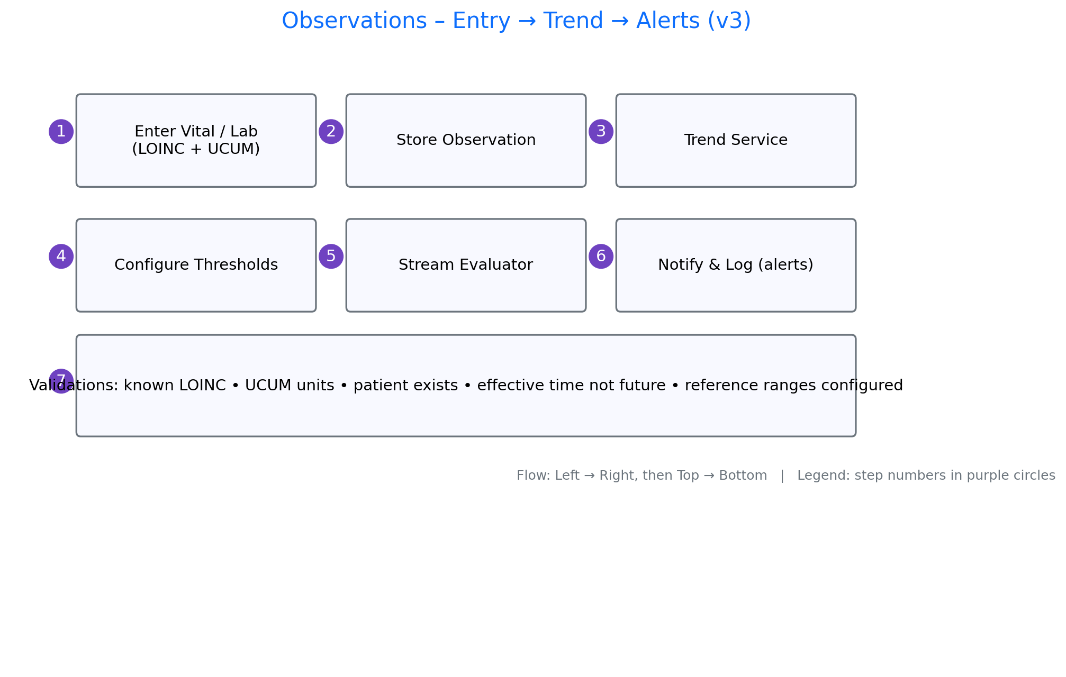
05 Observations Trends Alerts

Slide 7
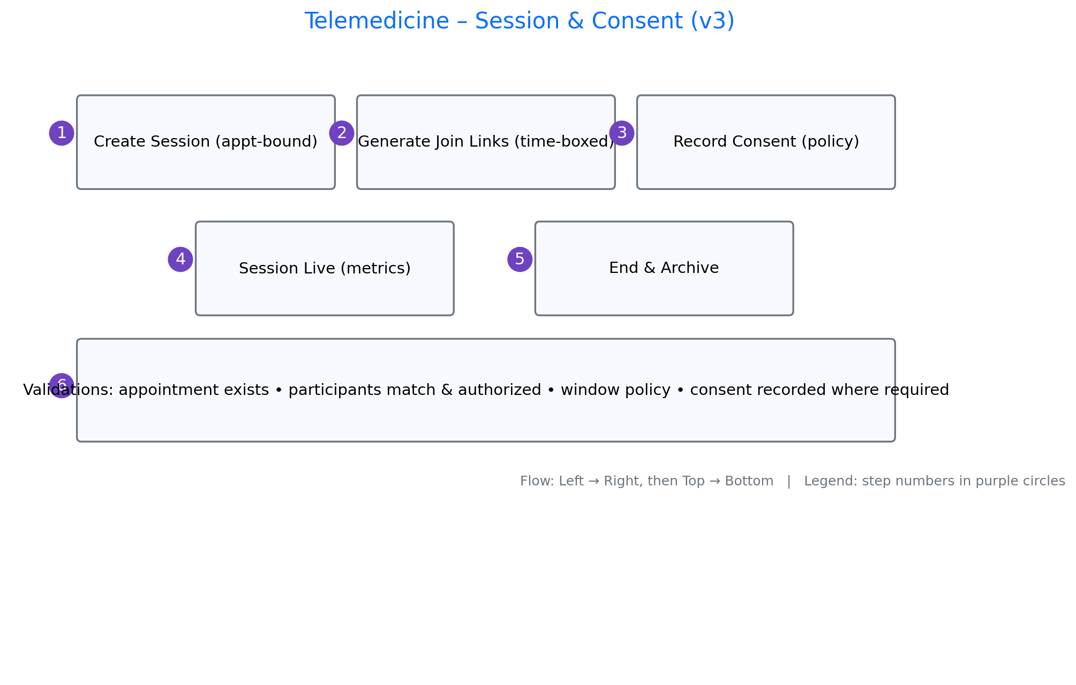
06 Telemedicine Consent

Slide 8
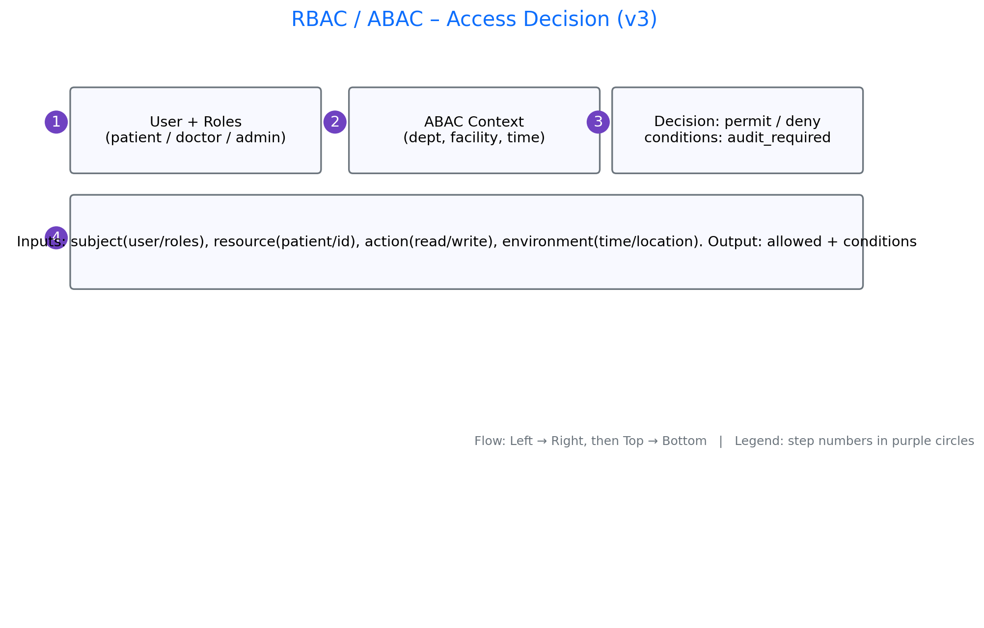
07 RBAC ABAC Decision

Slide 9
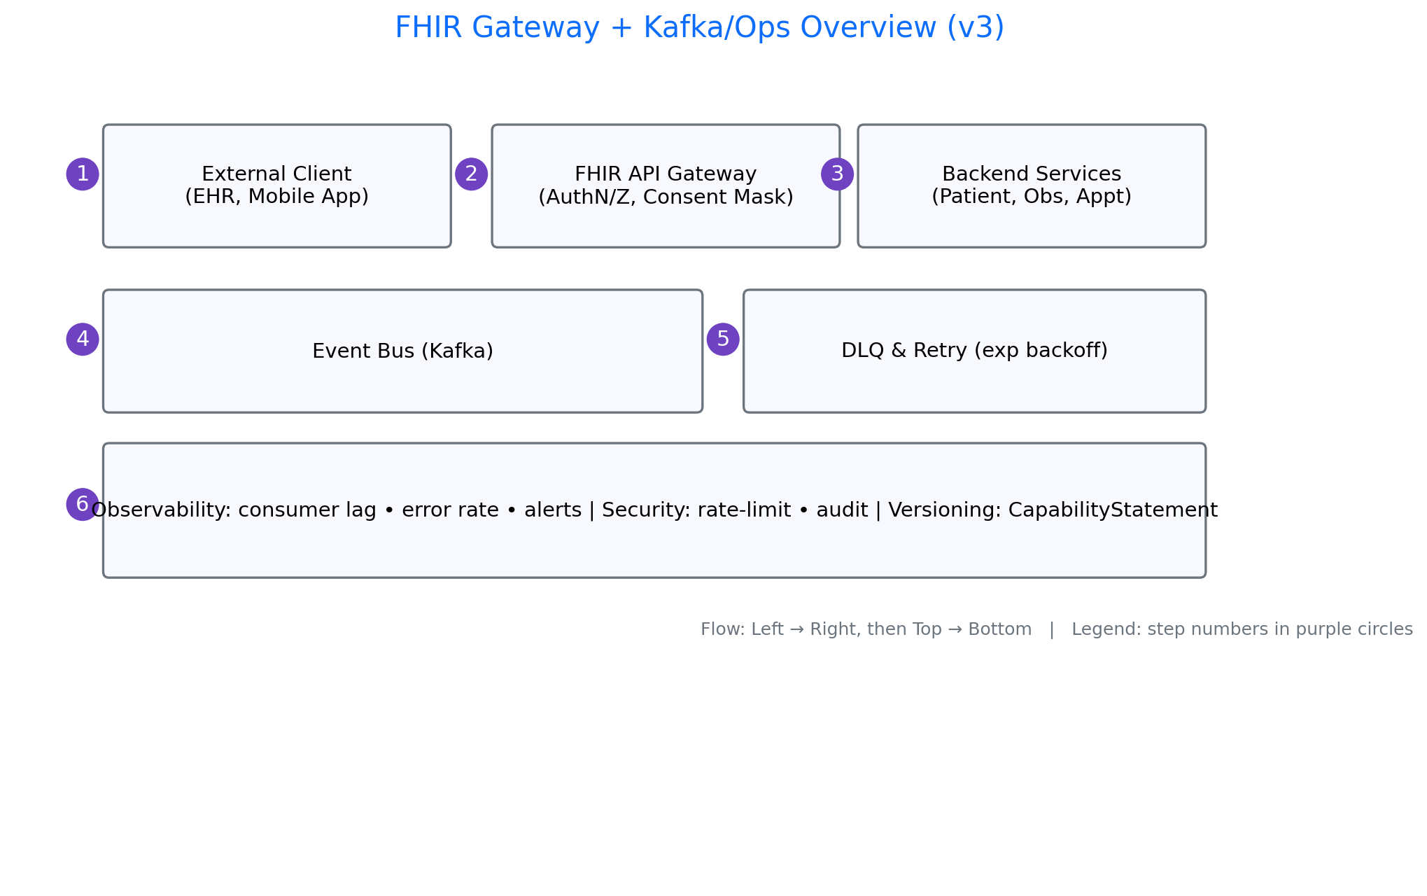
08 FHIR Gateway Kafka

